Slide 1



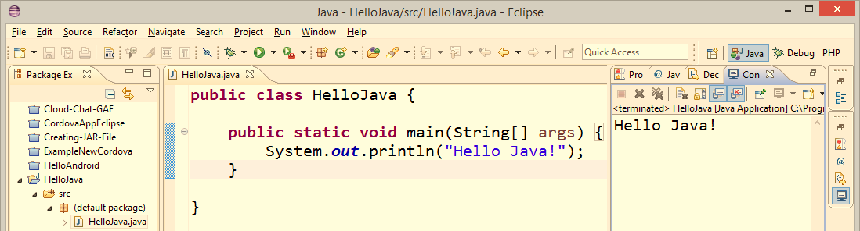
Java Syntax
Data Types, Variables, Operators, Expressions, Statements, Console I/O, Conditional Statements
SoftUni Team
Technical Trainers
Software University
http://softuni.bg

Slide 2


Table of Contents
Primitive Data Types
Variables
Operators and Expressions
Console-Based Input and Output
Regex API
Conditional Statements
Loops
Methods

Slide 3


Primitive Data Types in Java

Slide 4
How Computing Works?
Computers are machines that process data
Data is stored in the computer memory in variables
Variables have name, data type and value
Example of variable definition and assignment in Java
When processed, data is stored back into variables
Variable name
Data type
int count = 5;
Variable value

Slide 5



What Is a Data Type?
A data type:
Is a domain of values of similar characteristics
Defines the type of information stored in the computer memory (in a variable)
Examples:
Positive integers: 1, 2, 3, …
Alphabetical characters: a, b, c, …
Days of week: Monday, Tuesday, …

Slide 6


Data Type Characteristics
A data type has:
Name (Java keyword, e.g. int)
Size (how much memory is used)
Default value
Example:
Integer numbers in C#
Name: int
Size: 32 bits (4 bytes)
Default value: 0
int: sequence of 32 bits in the memory
int: 4 sequential bytes in the memory

Slide 7
Integer Types
byte (-128 to 127): signed 8-bit
short (-32,768 to 32,767): signed 16-bit
int (-2,147,483,648 to 2,147,483,647): signed 32-bit
long (-9,223,372,036,854,775,808 to 9,223,372,036,854,775,807): signed 64-bit
byte b = 1;
int i = 5;
long num = 3L;
short sum = (short) (b + i + num);
int
short
byte
long

Slide 8


Integer Types
Live Demo
int
byte
long
short

Slide 9

Floating-Point Types
Floating-point types are:
float (±1.5 × 10⁻⁴⁵ to ±3.4 × 10³⁸)
32-bits, precision of 7 digits
double (±5.0 × 10⁻³²⁴ to ±1.7 × 10³⁰⁸)
64-bits, precision of 15-16 digits
The default value of floating-point types:
Is 0.0F for the float type
Is 0.0D for the double type
double
float

Slide 10
Floating-Point Types – Examples
float f = 0.33f;
double d = 1.67;
double sum = f + d;
float fSum = f + d; // This will not compile
double infinity = 3.14 / 0;
System.out.println(f); // 0.33
System.out.println(d); // 1.67
System.out.println(sum); // 2.000000013113022
System.out.println(infinity); // Infinity

Slide 11
BigDecimal
The floating-point arithmetic sometime works incorrectly
Don't use float and double for financial calculations!
In Java use the BigDecimal class for financial calculations:
import java.math.BigDecimal;
…
BigDecimal bigF = new BigDecimal("0.33");
BigDecimal bigD = new BigDecimal("1.67");
BigDecimal bigSum = bigF.add(bigD);
System.out.println(bigSum); // 2.00

Slide 12

Floating-Point and BigDecimal Types
Live Demo

Slide 13
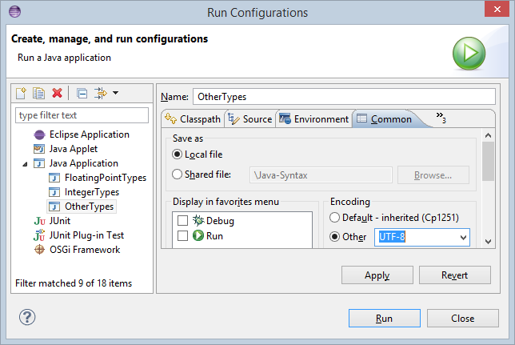
Other Primitive Data Types
Boolean
Enable Unicode in the Eclipse console
boolean b = true;
System.out.println(b); // true
System.out.println(!b); // false
Character
ch = 'ю';
System.out.println(ch);
ch = '\u03A9'; \\ Ω
System.out.println(ch);

Slide 14

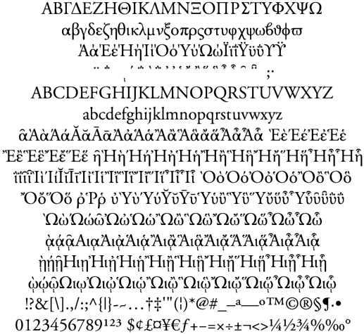

Boolean and Character Types
Live Demo
true
char
false

Slide 15

The String Data Type
The String data type:
Declared by the String class
Represents a sequence of characters
Has a default value null (no value)
Strings are enclosed in quotes:
Strings can be concatenated
Using the + operator
String
String s = "Hello, Java";

Slide 16
Saying Hello – Example
Concatenating the names of a person to obtain the full name:
We can concatenate strings and numbers as well:
String firstName = "Ivan";
String lastName = "Ivanov";
System.out.println("Hello, " + firstName);
String fullName = firstName + " " + lastName;
System.out.println("Your full name is: " + fullName);
int age = 21;
System.out.println("Hello, I am " + age + " years old");

Slide 17

String Type
Live Demo
string

Slide 18

The Object Type
The Object type:
Is declared by the java.lang.Object class
Is the base type of all other types
Can hold values of any type
Object
object dataContainer = 5;
System.out.print("The value of dataContainer is: ");
System.out.println(dataContainer);
dataContainer = "Five";
System.out.print("The value of dataContainer is: ");
System.out.println(dataContainer);

Slide 19

Objects
Live Demo
Object

Slide 20
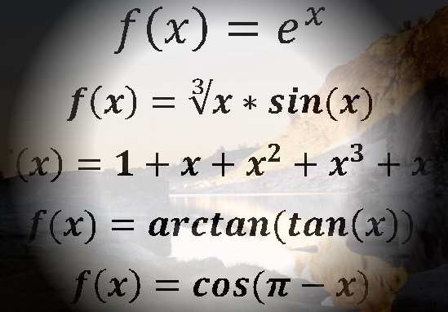


Variables, Identifiers, Literals
true
0xFE
"\uE52B"
6.02e+23
null
"\t\r\n\r\n\r\n"
counter
5
int

Slide 21
Declaring Variables
When declaring a variable we:
Specify its type
Specify its name (called identifier)
May give it an initial value
The syntax is the following:
Example:
height
200
int
<data_type> <identifier> [= <initialization>];
int height = 200;

Slide 22
Variable Scope
Variables in Java live inside their { } scope:
int sum = 0;
for (int i = 0; i < 10; i++) {
System.out.println(i);
sum += i;
int temp = 2*i;
}
System.out.println(sum); // sum will be printed here
System.out.println(i); // Error: i is out of scope here
System.out.println(temp); // Error: temp is out of scope here

Slide 23

Identifiers
Identifiers may consist of:
Letters (Unicode)
Digits [0-9]
Underscore "_"
Examples: count, firstName, Page, брояч, 计数器
Identifiers
Can begin only with a letter or an underscore
Cannot be a Java keyword (like int or class)

Slide 24
Literals in Java
Literals are the representations of values in the source code
int dec = 5; // decimal value 5
int hex = 0xFE; // hexadecimal value FE -> 254
int bin = 0b11001; // binary value 11001 -> 25
int bigNum = 1_250_000; // decimal value 1250000
long num = 1234567890123456789L;
long hexNum = 0x7FFF_FFFF_FFFF_FFFFL;
boolean bool = true;
float floatNum = 1.25e+7f; // 12500000
double doubleNum = 6.02e+23; // 602000000000000000000000
char newLine = '\n'; // Character <new line>
char unicodeChar = '\u00F1'; // Character: ñ
long fourBytes = 0b11010010_01101001_10010100_10010010; // -764832622
String str = "Hello,\nI\'m Java.";

Slide 25
Nullable Types: Integer, Long, Boolean, …
Each primitive type in Java has a corresponding wrapper:
int → java.lang.Integer
double → java.lang.Double
boolean → java.lang.Boolean
Primitive wrappers can have a value or be null (no value)
Integer i = 5; // Integer value: 5
i = i + 1; // Integer value: 6
i = null; // No value (null)
i = i + 1; // NullPointerException

Slide 26

Operators and Expressions in Java
int bit = (n & (1 << p)) >> p;
n = n & (~(1<<p)) | (bit<<p);

Slide 27
What is an Operator?
Operator is an operation performed over data at runtime
Takes one or more arguments (operands)
Produces a new value
Example of operators:
Operators have precedence
Precedence defines which will be evaluated first
Expressions are sequences of operators and operands that are evaluated to a single value, e.g. (a + b) / 2
Operator "+"
a = b + c;
Operator "="

Slide 28
Operators in Java
Category | Operators
Arithmetic | + - * / % ++ --
Logical | && || ^ !
Binary | & | ^ ~ << >> >>>
Comparison | == != < > <= >=
Assignment | = += -= *= /= %= &= |= ^= <<= >>= >>>=
String concatenation | +
Other | instanceof . [] () ?: new

Slide 29
Operators Precedence
Precedence | Operators
Highest | () [] .
 | ++ -- (postfix) new typeof
 | ++ -- (prefix) + - (unary) ! ~
 | * / %
 | + -
 | << >> >>>
 | < > <= >=
 | == !=
 | &
Lower | ^

Slide 30
Operators Precedence (2)
Precedence | Operators
Higher | |
 | &&
 | ||
 | ?:
 | = *= /= %= += -= <<= >>= >>>= &= ^= |=
Lowest | ,
Parenthesis operator always has the highest precedence
Note: prefer using parentheses to avoid ambiguity

Slide 31
Expressions
Expressions are sequences of operators, literals and variables that are evaluated to some value (formulas)
Examples:
int r = (150-20) / 2 + 5; // r=70
// Expression for calculating a circle area
double surface = Math.PI * r * r;
// Expression for calculating a circle perimeter
double perimeter = 2 * Math.PI * r;

Slide 32
Operators and Expressions – Examples
int x = 5, y = 2;
int div = x / y; // 2 (integral division)
float divFloat = (float)x / y; // 2.5 (floating-point division)
long num = 567_972_874; // 567972874
long mid3Digits = (num / 1000) % 1000; // 972
int z = x++; // z = x = 5; x = x + 1 = 6
boolean t = true;
boolean f = false;
boolean or = t || f;
boolean and = t && f;
boolean not = !t;

Slide 33
Operators and Expressions – Examples (2)
System.out.println(12 / 3); // 4
System.out.println(11 / 3); // 3
System.out.println(11.0 / 3); // 3.6666666666666665
System.out.println(11 / 3.0); // 3.6666666666666665
System.out.println(11 % 3); // 2
System.out.println(11 % -3); // 2
System.out.println(-11 % 3); // -2
System.out.println(1.5 / 0.0); // Infinity
System.out.println(-1.5 / 0.0); // -Infinity
System.out.println(0.0 / 0.0); // NaN
int zero = 0;
System.out.println(5 / zero); // ArithmeticException

Slide 34
Operators and Expressions – Examples (3)
short a = 3; // 00000000 00000011
short b = 5; // 00000000 00000101
System.out.println( a | b); // 00000000 00000111 --> 7
System.out.println( a & b); // 00000000 00000001 --> 1
System.out.println( a ^ b); // 00000000 00000110 --> 6
System.out.println(~a & b); // 00000000 00000100 --> 4
System.out.println( a << 1); // 00000000 00000110 --> 6
System.out.println( a >> 1); // 00000000 00000001 --> 1
System.out.println(a < b ? "smaller" : "larger");

Slide 35



Operators
Live Demo

Slide 36
Type Conversion
Type conversion and typecasting change one type to another:
long lng = 5;
int intVal = (int) lng; // Explicit type conversion
float heightInMeters = 1.74f; // Explicit conversion
double maxHeight = heightInMeters; // Implicit
double minHeight = (double) heightInMeters; // Explicit
float actualHeight = (float) maxHeight; // Explicit
//float maxHeightFloat = maxHeight; // Compilation error!
// Explicit type conversion with data loss
byte dataLoss = (byte)12345; // 57

Slide 37

Type Conversions
Live Demo

Slide 38
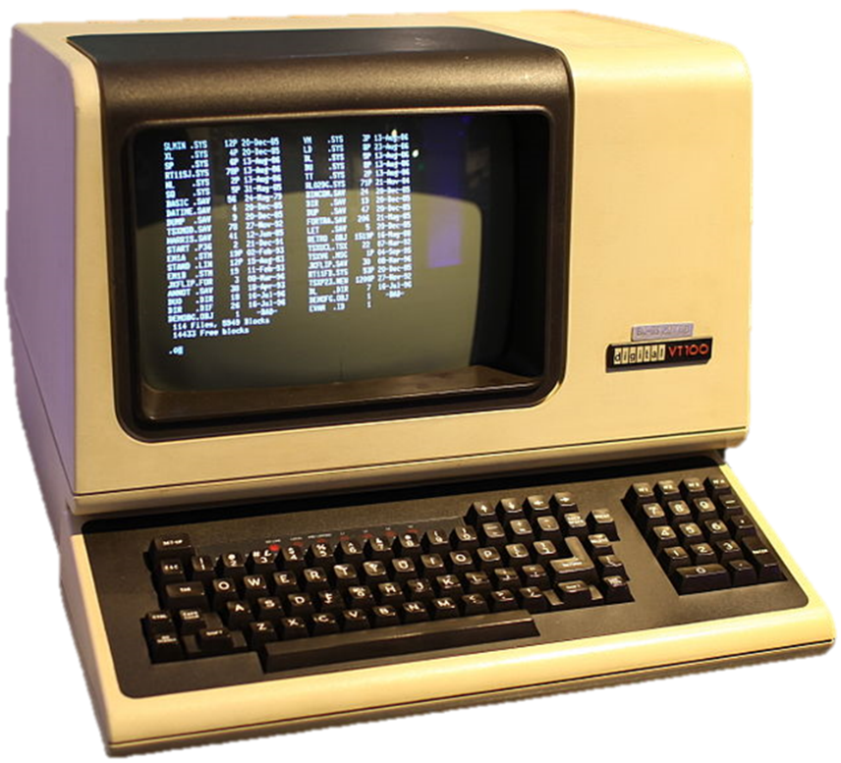


Console Input and Output
Scanner and Formatted Printing

Slide 39
Reading from the Console
The java.util.Scanner class reads strings and numbers
The numbers can be separated by any sequence of whitespace characters (e.g. spaces, tabs, new lines, …)
Exception is thrown when non-number characters are entered
import java.util.Scanner;
…
Scanner input = new Scanner(System.in);
int firstNum = input.nextInt();
int secondNum = input.nextInt();
Sample Inputs
3
-5
3 -5

Slide 40
Reading from the Console (2)
A more complex example:
Read two words from the first line
Integer and two doubles from the second line
A string from the third line
Scanner input = new Scanner(System.in);
String firstWord = input.next("\\w+");
String secondWord = input.next("\\w+");
int numInt = input.nextInt();
double numDouble1 = input.nextDouble();
double numDouble2 = input.nextDouble();
input.nextLine(); // Skip to the line end
String str = input.nextLine();

Slide 41
Reading from the Console
Live Demo

Slide 42
Printing to the Console
Using System.out.print() and System.out.println():
String name = "SoftUni";
String location = "Sofia";
double age = 0.5;
System.out.print(name);
System.out.println(" is " + age +
" years old organization located in " + location + ".");
// Output:
// SoftUni is 0.5 years old organization located in Sofia.

Slide 43
Formatted Printing
Java supports formatted printing by System.out.printf()
%s – prints a string argument
%f – prints a floating-point argument
%.2f – prints a floating-point argument with 2 digits precision
String name = "SoftUni";
String location = "Sofia";
double age = 0.5;
System.out.printf(
"%s is %.2f years old organization located in %s.",
name, age, location);

Slide 44
Formatted Printing (2)
%td / %tm / %tY – prints day / month / year from a date
%1$f – prints the first argument as floating-point number
%2$d – prints the second argument as integer number
System.out.printf(
"Today is %1$td.%1$tm.%1$tY\n",
LocalDate.now());
// Today is 10.05.2014
System.out.printf("%1$d + %1$d = %2$d\n", 2, 4);
// 2 + 2 = 4
Learn more at http://docs.oracle.com/javase/8/docs/api/java/util/Formatter.html

Slide 45


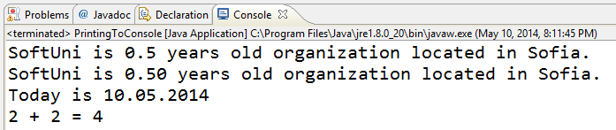
Printing to the Console
Live Demo

Slide 46

Regex API

Slide 47
Regular Expressions
Regular expressions match text by pattern, e.g.
[0-9]+ matches a non-empty sequence of digits
[a-zA-Z]* matches a sequence of letters (including empty)
[A-Z][a-z]+ [A-Z][a-z]+ matches a name (first name + space + last name)
\s+ matches any whitespace; \S+ matches non-whitespace
\d+ matches digits; \D+ matches non-digits
\w+ matches letters (Unicode); \W+ matches non-letters
\+\d{1,3}([ -]*[0-9]+)+ matches international phone

Slide 48
Validation by Regular Expression – Example
import java.util.regex.*;
…
String regex = "\\+\\d{1,3}([ -]*[0-9]+)+";
System.out.println("+359 2 981-981".matches(regex)); // true
System.out.println("invalid number".matches(regex)); // false
System.out.println("+359 123-".matches(regex)); // false
System.out.println("+359 (2) 981 981".matches(regex)); // false
System.out.println("+44 280 11 11".matches(regex)); // true
System.out.println("++44 280 11 11".matches(regex)); // false
System.out.println("(+49) 325 908 44".matches(regex)); // false
System.out.println("+49 325 908-40-40".matches(regex)); // true

Slide 49
Regex API
Pattern – a compiled representation of a regular expression.
Matcher – an engine that performs match operations on a character sequence by interpreting a Pattern.
import java.util.regex.*;
…
String text =
"Hello, my number in Sofia is +359 894 11 22 33, " +
"but in Munich my number is +49 89 975-99222.";
Pattern phonePattern = Pattern.compile(
"\\+\\d{1,3}([ -]*([0-9]+))+");
Matcher matcher = phonePattern.matcher(text);
while (matcher.find()) {
System.out.println(matcher.group());
}

Slide 50
Matcher methods
matches – attempts to match the entire input.
lookingAt – attempts to match the input sequence, starting at the beginning.
find – scans the input sequence looking for the next subsequence that matches the pattern.
start – returns the start index of the previous match.
end – returns the offset after the last character matched.
group – returns the input subsequence matched by the previous match.

Slide 51

Regex API
Live Demo

Slide 52



Regional Settings
Regional Settings and the Number Formatting

Slide 53
Locale
Locales in Java define the country and language specific formatting rules
Reading / printing to the console is locale-dependent
The Bulgarian locale uses "," as decimal separator, e.g. 1,25
The United States locale uses "." as decimal separator, e.g. 1.25
Changing the System locale (for the entire VM)
Locale.setDefault(Locale.ROOT); // Language-neutral locale
Locale.setDefault(new Locale("BG", "BG")); // Bulgarian
Locale.setDefault(Locale.US); // United States

Slide 54
Locale-Specific Input and Output
int age = 0.5;
Locale.setDefault(Locale.ROOT);
System.out.printf("%f\n", age); // 0.500000
System.out.println(age); // 0.5
Scanner inputRoot = new Scanner(System.in);
double d = inputRoot.nextDouble(); // Expects 1.25
Locale.setDefault(new Locale("BG", "BG"));
System.out.printf("%f\n", age); // 0,500000
System.out.println(age); // 0.5
Scanner inputBG = new Scanner(System.in);
d = inputBG.nextDouble(); // Expects 1,25

Slide 55

Regional Settings
Live Demo

Slide 56
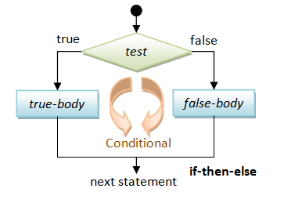
if and if-else
Implementing Conditional Logic

Slide 57
Conditional Statements: if-else
Java implements the classical if / if-else statements:
Scanner scanner = new Scanner(System.in);
int number = Integer.parseInt(scanner.nextLine());
if (number % 2 == 0) {
System.out.println("This number is even.");
} else {
System.out.println("This number is odd.");
}

Slide 58
if and if-else
Live Demo

Slide 59
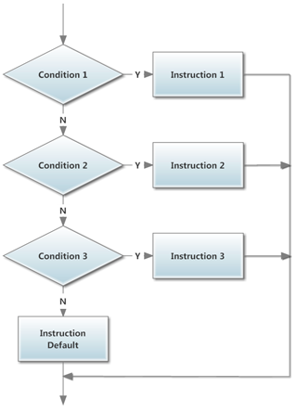
switch-case
Checking Multiple Conditions

Slide 60
Conditional Statements: switch-case
Java implements the classical switch-case statements:
switch (day) {
case 1: System.out.println("Monday"); break;
case 2: System.out.println("Tuesday"); break;
case 3: System.out.println("Wednesday"); break;
case 4: System.out.println("Thursday"); break;
case 5: System.out.println("Friday"); break;
case 6: System.out.println("Saturday"); break;
case 7: System.out.println("Sunday"); break;
default: System.out.println("Invalid day!"); break;
}

Slide 61
switch-case
Live Demo

Slide 62



Loops

Slide 63

Loop: Definition
A loop is a control statement that repeats the execution of a block of statements
May execute a code block fixed number of times
May execute a code block while given condition holds
May execute a code block for each member of a collection
Loops that never end are called an infinite loops
while (condition) {
statements;
}

Slide 64
While Loop
The simplest and most frequently used loop
The repeat condition
Returns a boolean result of true or false
Also called loop condition
while (condition) {
statements;
}

Slide 65
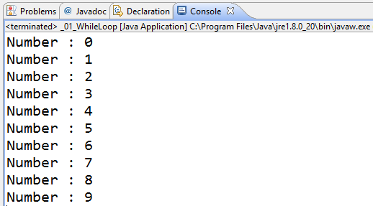
While Loop – Example: Numbers 0…9
int counter = 0;
while (counter < 10) {
System.out.printf("Number : %d\n", counter);
counter++;
}

Slide 66
Do-While Loop
Another classical loop structure is:
The block of statements is repeated
While the boolean loop condition holds
The loop is executed at least once
do {
statements;
}
while (condition);

Slide 67
Product of Numbers [N..M] – Example
Calculating the product of all numbers in the interval [n..m]:
Scanner input = new Scanner(System.in);
int n = input.nextInt();
int m = input.nextInt();
int number = n;
BigInteger product = BigInteger.ONE;
do {
BigInteger numberBig = new BigInteger("" + number);
product = product.multiply(numberBig);
number++;;
}
while (number <= m);
System.out.printf("product[%d..%d] = %d\n", n, m, product);

Slide 68
For Loops
The classical for-loop syntax is:
Consists of
Initialization statement
Boolean test expression
Update statement
Loop body block
for (initialization; test; update) { statements; }

Slide 69
For Loop – Examples
A simple for-loop to print the numbers 0…9:
for (int number = 0; number < 10; number++) {
System.out.print(number + " ");
}
A simple for-loop to calculate n!:
long factorial = 1;
for (int i = 1; i <= n; i++) {
factorial *= i;
}

Slide 70
Using the continue Operator
continue bypasses the iteration of the inner-most loop
Example: sum all odd numbers in [1…n], not divisors of 7:
int n = 100;
int sum = 0;
for (int i = 1; i <= n; i += 2) {
if (i % 7 == 0) {
continue;
}
sum += i;
}
System.out.println("sum = " + sum);

Slide 71
Using the break Operator
The break operator exits the inner-most loop
public static void main(String[] args) {
int n = new Scanner(System.in).nextInt();
// Calculate n! = 1 * 2 * ... * n
int result = 1;
while (true) {
if (n == 1)
break;
result *= n;
n--;
}
System.out.println("n! = " + result);
}

Slide 72
For-Each Loop
The typical for-each loop syntax is:
Iterates over all the elements of a collection
The element is the loop variable that takes sequentially all collection values
The collection can be list, array or other group of elements of the same type
for (Type element : collection) { statements; }

Slide 73
For-Each Loop – Example
Example of for-each loop:
The loop iterates over the array of day names
The variable day takes all its values
Applicable for all collections: arrays, lists, strings, etc.
String[] days = { "Monday", "Tuesday", "Wednesday",
"Thursday", "Friday", "Saturday", "Sunday" };
for (String day : days) {
System.out.println(day);
}

Slide 74
Nested Loops
Loops can be nested (one inside another)
Example: print all combinations from TOTO 6/49 lottery
for (int i1 = 1; i1 <= 44; i1++)
for (int i2 = i1 + 1; i2 <= 45; i2++)
for (int i3 = i2 + 1; i3 <= 46; i3++)
for (int i4 = i3 + 1; i4 <= 47; i4++)
for (int i5 = i4 + 1; i5 <= 48; i5++)
for (int i6 = i5 + 1; i6 <= 49; i6++)
System.out.printf("%d %d %d %d %d %d\n",
i1, i2, i3, i4, i5, i6);

Slide 75

Loops
Live Demo

Slide 76
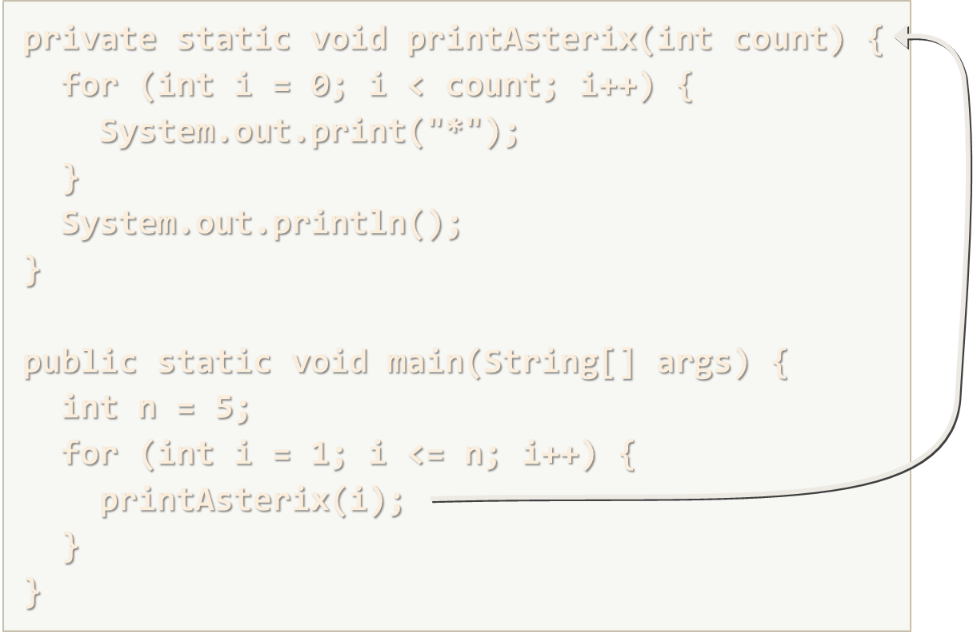
Methods
Defining and Invoking Methods

Slide 77
Methods: Defining and Invoking
Methods are named pieces of code
Defined in the class body
Can be invoked multiple times
Can take parameters
Can return a value
private static void printAsterix(int count) {
for (int i = 0; i < count; i++) {
System.out.print("*");
}
System.out.println();
}
public static void main(String[] args) {
int n = 5;
for (int i = 1; i <= n; i++) {
printAsterix(i);
}
}

Slide 78


Methods: Parameters
Executing a method without parameters.
Executing a method with parameters.
private static House buildHouse() {
House newHouse = Builder.buildSmallHouse();
return newHouse;
}
private static House paintHouse(House h) {
House paintedHouse= Painter.paint(h;
return paintedHouse;
}

Slide 79

Methods: Parameters Overloading
Methods overloading.
private static House buildHouse() {
House newHouse = Builder.buildSmallHouse();
return newHouse;
}
private static House buildHouse(Concrete c) {
House newHouse = Builder.buildHouseWith(c);
return newHouse;
}
private static House buildHouse(Bricks b) {
House newHouse = Builder.buildHouseWith(b);
return newHouse;
}

Slide 80
Methods: Returning Value
Void methods.
Returning value methods.
private static void logStatus(String status) {
Logger log = new Logger();
log.newLine(status);
}
private static Product createProduct(RawMaterial mat) {
Product newProduct = ProductCreator.createFrom(mat);
return newProduct;
}

Slide 81
Methods with Parameters and Return Value
static double calcTriangleArea(double width, double height) {
return width * height / 2;
}
public static void main(String[] args) {
Scanner input = new Scanner(System.in);
System.out.print("Enter triangle width: ");
double width = input.nextDouble();
System.out.print("Enter triangle height: ");
double height = input.nextDouble();
System.out.println("Area = " + calcTriangleArea(width, height));
}
Method names in Java should be in camelCase

Slide 82
Recursion
Recursion == method can calls itself
public static void main(String[] args) {
int n = 5;
long factorial = calcFactorial(n);
System.out.printf("%d! = %d", n, factorial);
}
private static long calcFactorial(int n) {
if (n <= 1) {
return 1;
}
return n * calcFactorial(n-1);
}

Slide 83
Method Return Types
Type void
Does not return a value directly by itself
Other types
Return values, based on the return type of the method
static void addOne(int n) {
n += 1;
System.out.println(n);
}
static int plusOne(int n) {
return n + 1;
}

Slide 84
Method Access Modifiers
private
Accessible only inside the current class. No subclass can call this
package (default)
Accessible only inside the package. Subclasses can call this
protected
Accessible by subclasses even outside the current package
public
All code can access this, e.g. external classes

Slide 85
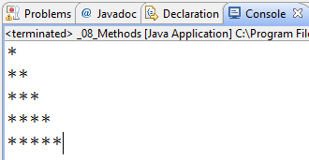
Methods
Live Demo

Slide 86

Summary
Java supports limited set of primitive data types
Java supports the classical operators, expressions and statements
Scanner and System.out.printf() provide formatted input / output
Java supports the classical if-else and switch-case
Java supports the classical loop constructs
Java support methods

Slide 87










Java Syntax
https://softuni.bg/courses/java-basics/

Slide 88
License
This course (slides, examples, demos, videos, homework, etc.) is licensed under the "Creative Commons Attribution-NonCommercial-ShareAlike 4.0 International" license
Attribution: this work may contain portions from
"Fundamentals of Computer Programming with Java" book by Svetlin Nakov & Co. under CC-BY-SA license
"C# Basics" course by Software University under CC-BY-NC-SA license

Slide 89





Free Trainings @ Software University
Software University Foundation – softuni.org
Software University – High-Quality Education, Profession and Job for Software Developers
softuni.bg
Software University @ Facebook
facebook.com/SoftwareUniversity
Software University @ YouTube
youtube.com/SoftwareUniversity
Software University Forums – forum.softuni.bg

